Slide 1
The myth of Scylla and Charybdis
By Telesio Primary School

Slide 2
Scylla and Charybdis were two mythical sea monsters living on opposite sides of the Strait of Messina between Italy and Sicily.

Slide 3
Scylla was once a beautiful sea nymph loved by the sea god Glaucus.

Slide 4
Glaucus went to the witch Circe and asked her for a love potion to make Scylla return his love.

Slide 5
Circe fell in love for Glaucus and, jealous of Scylla, used her magic to transform her into a monster with twelve feet and six heads.

Slide 6
Scylla hid herself in a cave in the Strait of Messina and, when ships passed close by her, she struck out to grab and eat the sailors.

Slide 7
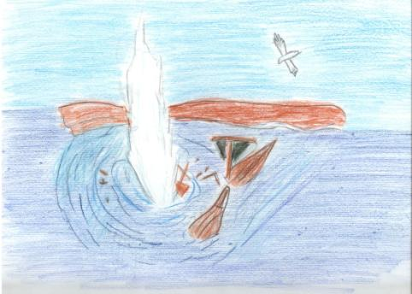
Charybdis was a dangerous sea monster, who lived in the Strait of Messina, opposite Scylla. Three times a day, it swallowed a huge amount of water, before belching it back out again, creating large whirlpools capable of dragging a ship underwater.

Slide 8
Ships sailing the strait were almost certain to be destroyed by one of the monsters.

